Slide 1
Identifying amino acid predominant mutations in viruses by comparing matrices
Ankit Mukherjee
Guide: Dr. Shekhar C. Mande

Slide 2
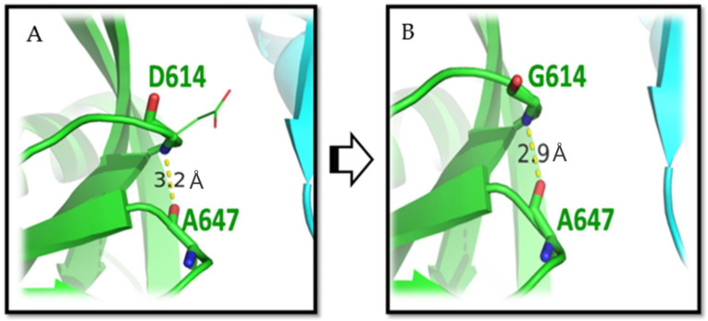
INTRODUCTION
Viruses have the ability to mutate spontaneously ultimately reflecting structural differences.
Amino acid substitution matrices can help in studying which mutations are more likely to occur than expected by chance.

Slide 3
RESEARCH OBJECTIVES
Comparing amino acid substitution matrix derived from viral proteins under selection pressure to general purpose matrix like PAM and BLOSUM to identify amino acid predominant mutations.
Mapping the mutations onto the protein structure to identify their respective locations spatially.
The overarching biological question to be addressed is why amino acids at these specific positions within the proteins undergo frequent mutations. This investigation aims to determine whether these mutations confer a selective advantage to the virus in the host-pathogen race, potentially increasing viral susceptibility.

Slide 4
METHODOLOGY
Selecting Viruses And Their Corresponding Proteins
Selected mainly RNA viruses for study due to their high mutation rate, single-stranded genome, high availability of sequences and representative virus of different families.
Selected proteins from each RNA virus that are under selection pressure and as control proteins that are not (on the basis of d_{N}/d_{S} ratio).

Slide 5
Filtering Proteins Before MSA
Using CD-HIT to keep only unique sequences by removing sequences which are 100% similar.
Filtering sequences by length (decided on the basis of the length of the protein).
Removing sequences which contain ambiguous characters.
Performing MSA using MAFFT. Sequences containing large gaps were removed and MSA was performed again.

Slide 6
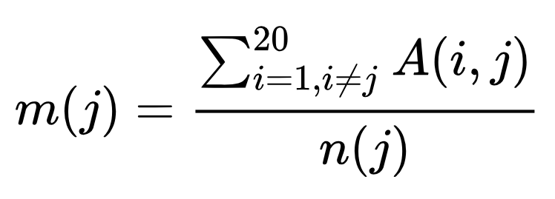
Algorithm Of PAM Amino Acid Substitution Matrix
Filling up the accepted point mutation matrix with amino acid differences between each pair of sequences.
The assumption that the likelihood of amino acid X replacing Y is the same as that of Y replacing X is met by transposing the matrix and then dividing each element by 2. This makes the matrix symmetric.
Relative Mutability of Amino Acids:

Slide 7
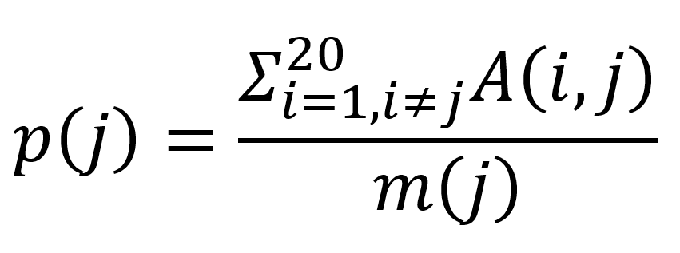
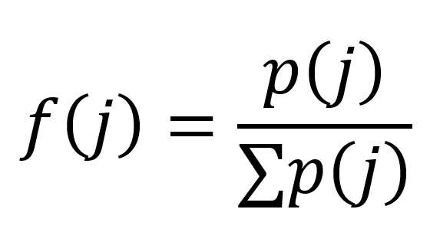
Normalized Frequencies of the Amino Acids (f(j)):
Background probability of each amino acid.
Normalization is carried out by dividing each value by the sum of the background frequencies.

Slide 8
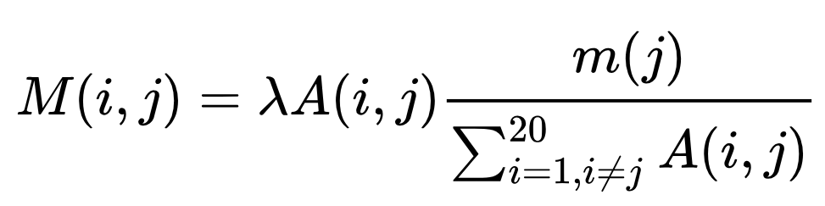
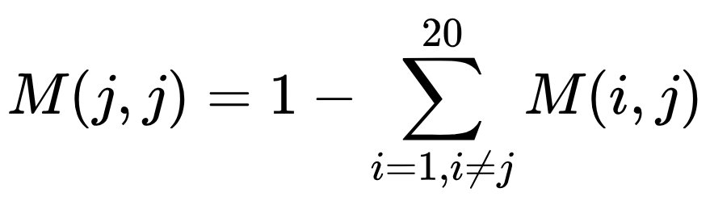
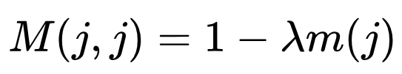
Construction of the mutation matrix:
Non – Diagonal Elements:
Diagonal Elements:
simplifies to -

Slide 9
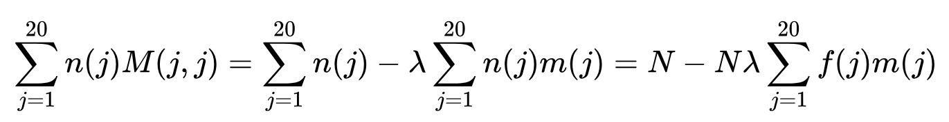
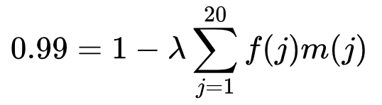
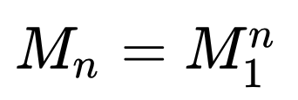
Choice of the constant of proportionality (λ):
The value of λ needed to be pick to produce 99% identity after mutation:
Construction of PAM_{n} matrices:

Slide 10
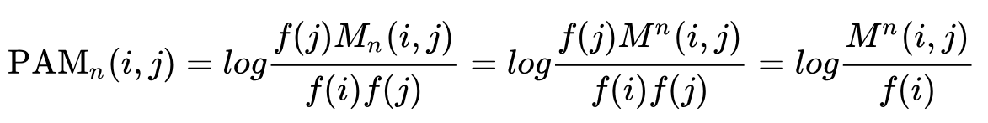
Log Odds Matrix

Slide 11
RESULTS
Virus | Protein Under Selection Pressure | Control
SARS – CoV – 2 | Spike Protein | M Protein
Influenza A Virus | HA and NA Proteins | M1 Protein
Human Immunodeficiency Virus | Env Protein | Gag Protein
Hepatitis C Virus | E2 Protein | Core Protein
Hepatitis B Virus | L Protein | Core Protein

Slide 12
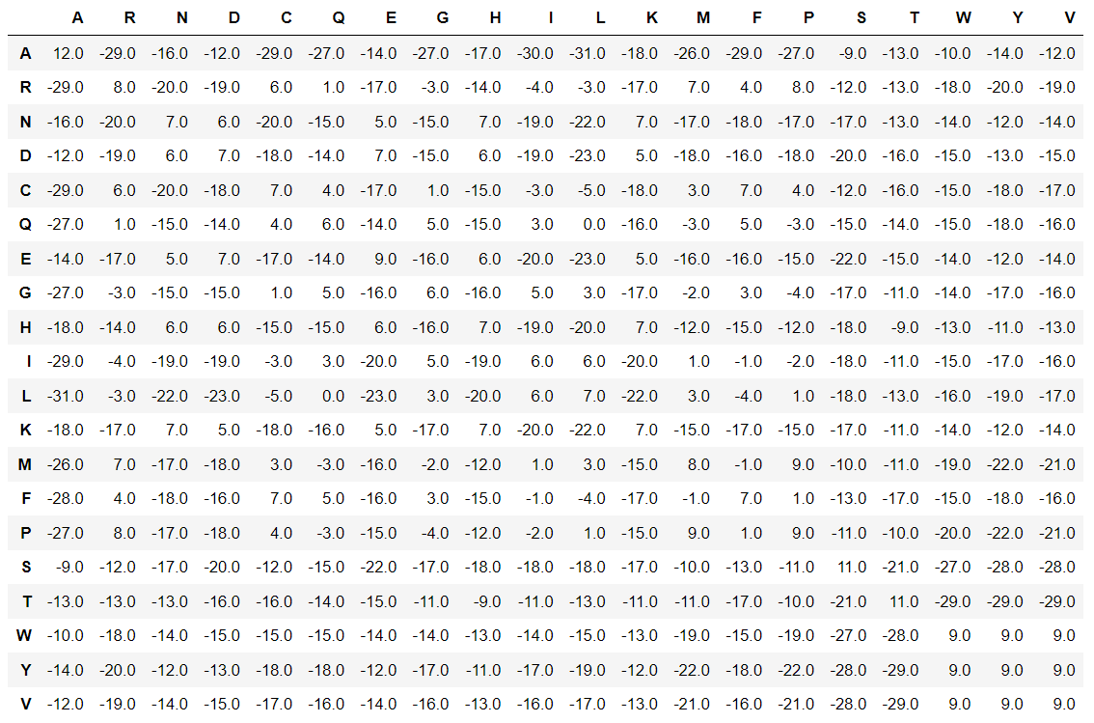
PAM250 Matrix Derived from Spike Protein

Slide 13
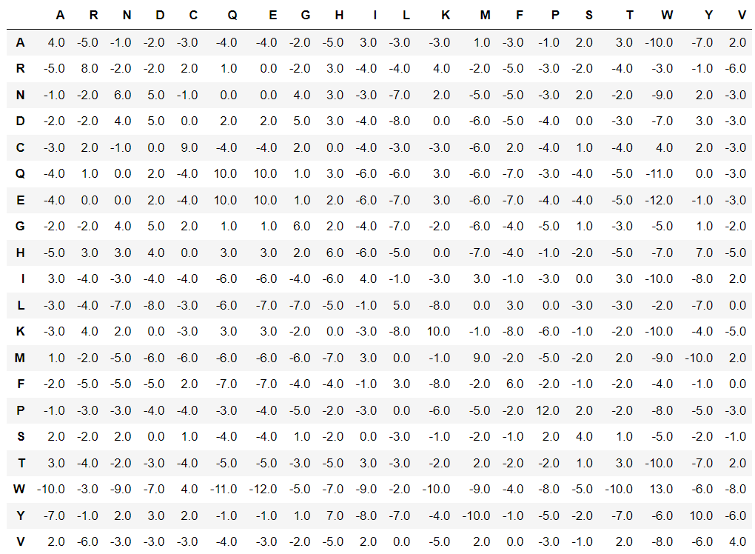
PAM250 Matrix Derived from M (Matrix) Protein (Control)

Slide 14
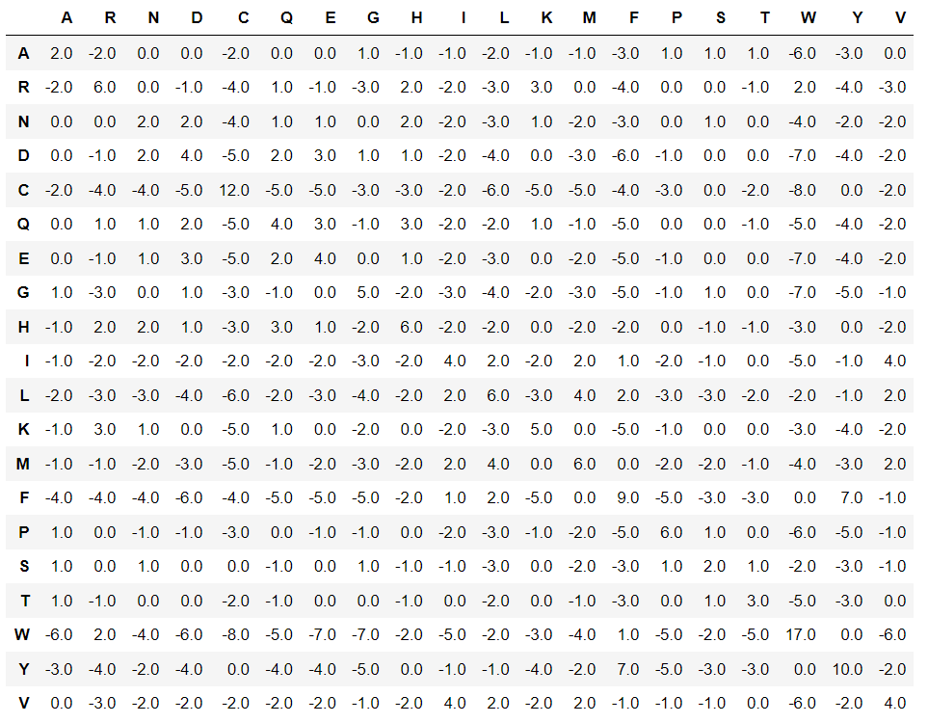
Dayhoff PAM250 Matrix

Slide 15
FUTURE PROSPECT
Comparing PAM matrices of the protein under selection pressure as well as the control with Dayhoff matrices to find whether there is a significant change or not.
This would be done for all the viruses that I have chosen to establish the methodology.
BLOSUM being a better matrix than PAM can also be derived for better comparison.
Identifying the biology behind the occurrence of such predominant mutations affecting the protein structure and ultimately the capability of the virus affecting the host.

Slide 16
ACKNOWLEDGEMENT
I extend my heartfelt appreciation to Dr. Shekhar Mande for generously dedicating his valuable time to contribute to my project.
Additionally, I am immensely grateful to Dr. Payel Ghosh for her unwavering support and guidance throughout the entire process.
Their expertise and assistance have been invaluable, and I am truly thankful to Bithika Chatterjee, my family and friends (Pradnya) for the success of my project.

Slide 17
REFERENCES
Dayhoff MO, Schwartz RM, Orcutt BC (1978). "A model of Evolutionary Change in Proteins". Atlas of protein sequence and structure (volume 5, supplement 3 ed.). Washington, DC.: National Biomedical Research Foundation. pp. 345–358. ISBN 978-0-912466-07-1
Alqahtani, A.; Almutairy, M. Evaluating the Performance of Multiple Sequence Alignment Programs with Application to Genotyping SARS-CoV-2 in the Saudi Population. Computation 2023, 11, 212. https://doi.org/10.3390/computation11110212
Li, S., Wang, Z., Li, Y. et al. Adaptive evolution of proteins in hepatitis B virus during divergence of genotypes. Sci Rep 7, 1990 (2017). https://doi.org/10.1038/s41598-017-02012-8
Tusche C, Steinbrück L, McHardy AC. Detecting patches of protein sites of influenza A viruses under positive selection. Mol Biol Evol. 2012 Aug;29(8):2063-71. doi: 10.1093/molbev/mss095. Epub 2012 Mar 16. PMID: 22427709; PMCID: PMC3408068.
Louie RHY, Kaczorowski KJ, Barton JP, Chakraborty AK, McKay MR. Fitness landscape of the human immunodeficiency virus envelope protein that is targeted by antibodies. Proc Natl Acad Sci U S A. 2018 Jan 23;115(4):E564-E573. doi: 10.1073/pnas.1717765115. Epub 2018 Jan 8. PMID: 29311326; PMCID: PMC5789945.
Cuypers L, Li G, Libin P, Piampongsant S, Vandamme AM, Theys K. Genetic Diversity and Selective Pressure in Hepatitis C Virus Genotypes 1-6: Significance for Direct-Acting Antiviral Treatment and Drug Resistance. Viruses. 2015 Sep 16;7(9):5018-39. doi: 10.3390/v7092857. PMID: 26389941; PMCID: PMC4584301.
Emam M, Oweda M, Antunes A, El-Hadidi M. Positive selection as a key player for SARS-CoV-2 pathogenicity: Insights into ORF1ab, S and E genes. Virus Res. 2021 Sep;302:198472. doi: 10.1016/j.virusres.2021.198472. Epub 2021 Jun 10. PMID: 34118359; PMCID: PMC8190378.
https://en.wikipedia.org/wiki/Point_accepted_mutation

Slide 18
THANK YOU

